Slide 1

Topic – Open Innovation
Team Name - Bold Brainiacs
Team Members Details
Team Leader Name-Putul Mondal(IT-3rd) Team Member Name - Poulami Das(CSE-3rd)
Team Member Name - Plaban Kumar Nath(IT-3rd)

Slide 2


PROBLEM STATEMENT
Huge amount of peaple from different corner of world want to explore Indian heritage,holy places and other sites and many youngs are interested in treaking
as those types of peaple in many time dont able make a good planning for lack of information.

Slide 3

SOLUTION
Our travel planer will help that people who are basically belonging from India and not belonging from India also. That website will provide the current updates and how to reach that particular place have been selected by traveler and in which caravansary they will take rest they can do the full planning by this web site.

Slide 4

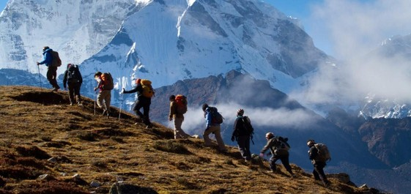

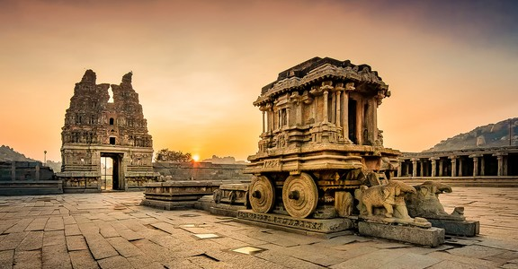
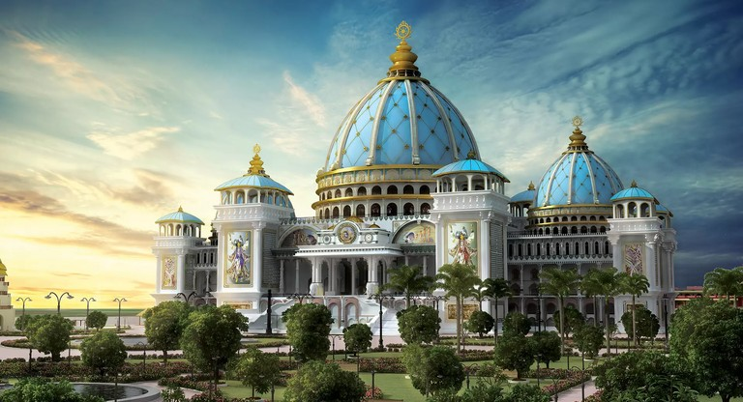
THERE ARE FOUR INNOVATIVE PILLERS
TREAKING
One of most attraction part of this site is that will help you offers a wide range of trekking options for adventure enthusiasts, from beginners to experienced trekkers, with various levels of difficulty and scenic beauty.
HERITAGE
This part will always provide the current updates which will help travelers to decide where to go and where that particular time or not.
PILGRIMS
This site will help those people who are interested to visit the holy places of INDIA.
CURRENT UPDATES
That site will showcase the heritage sites and information about that sites by this those travelers who
want to visit the India's heritage sites only this site will make their journey and make their plan easier.

Slide 5
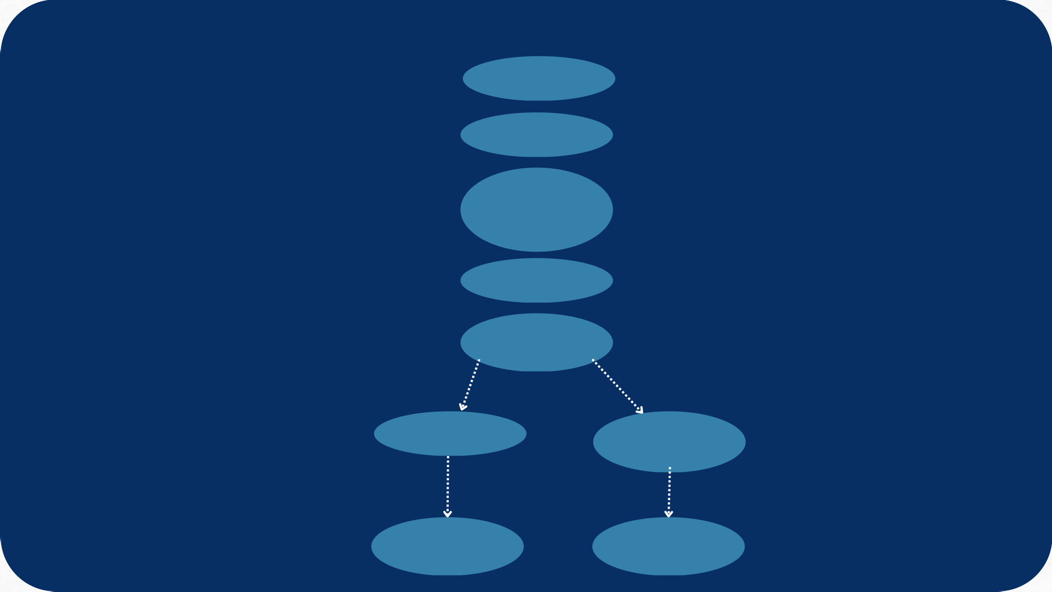

USE CASE DIAGRAM
Login/Register
Search a Place
Chosse Heritage/Pilgri ms/Treaking
Explore
Planning for trip
User
<<include>>
<<include>>
Database
Solo Trip
get a travel agent
<<include>>
<<include>>
Get route Details
get agent details

Slide 6


FLOW CHART
Start
Login
Select Destination
Explore
Planning For Trip
Solo Trip
Get local travel agent
Get the best route with google map and all expenses details
Get all travel agents details

Slide 7




TECH STACK
FRONTEND
BACKEND
DATABASE
FUTURE SCOPE
Initially this site will help to explore the Indian’s places but in future that will help to explore the places of foreign country also.
We want to develop this site to help the researchers who are belonging from India or Foreign country and not able to visit that site currently the can explore that site virtually and check all the information and every corner of that place .To do this type of work they have submit valid document to the authority and that places’s protected team to verify they are actually came for research .

